Slide 1

Exploratory Data Analysis
Taxi and Cab Investment Analysis
March 2023

Slide 2

Executive Summary
OBJECTIVE
XYZ is a private company interested in investing in the rapidly growing taxi and cab industry. In order to make informed investment decisions, they are conducting a detailed exploratory data analysis and data mining of major cities across the United States. The objective is to provide actionable insights and identify trends that can inform strategic investment decisions.
PROBLEM STATEMENT
Investigate the data sources to provide accurate explanatory data analysis to help decision makers gain insight to the cab and taxi industry and select the best option to invest.
SUCCESS CRITERIA
Presentation for the XYZ's stakeholders and executive team via visuals to help them in decision making process.

Slide 3
Analytical Approach
APPROACHES AND ANALYTICAL HYPOTHESIS:
Which Company has the best profit on sales over the others?
Which city has the most profit and average profit per trip among the others?
Are there any seasonality in the using of cusomer? What timeframe does it have?
Cab demand is higher on weekends than weekdays?
Is there any changes of demand exists in the US Holidays?
Is there a difference in the average fare price between different cab companies?
Is there a significant difference in sales or profit based on the type of payment method used by customers?

Slide 4
Dataset and Feature Extraction
DATA INGEST
Cab Data
Customer ID
Master Dataset
Transaction ID
City
US Holiday
Master Dataset Info
14 features
359,392 Observations
No Missing Values
No duplicate observation
Feature Transformation
Binning population
Binning Users
Creating ‘Population Per Capita’ feature
Creating ‘Profit’ feature by ‘Price Charged’ – ‘Cost of Trip’
Creating ‘Profit Per KM’ by ‘Profit’ / ‘KM Travelled’
Date transformations

Slide 5
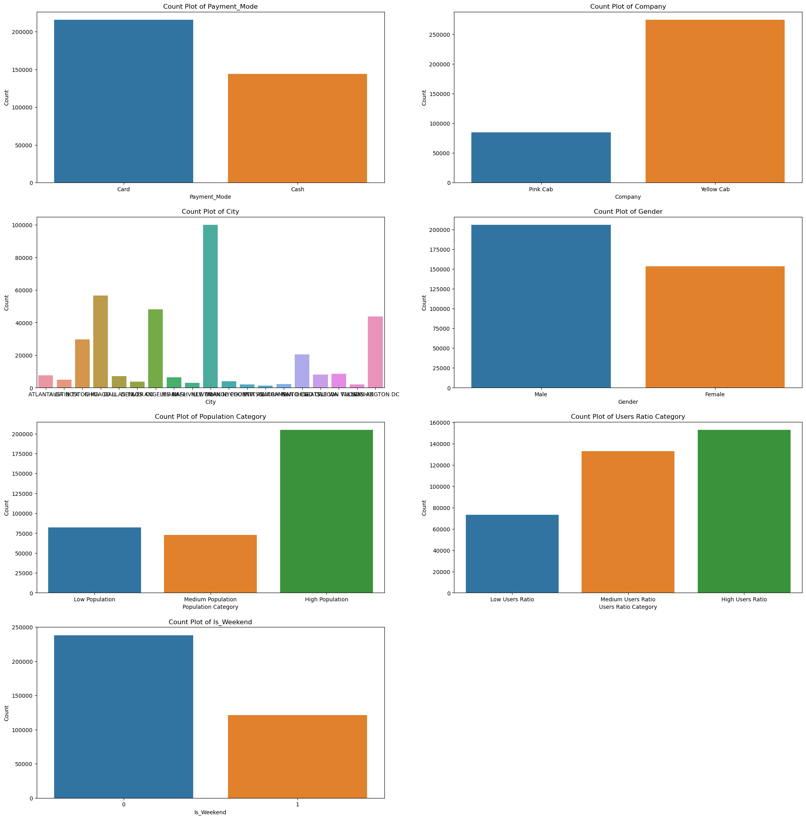
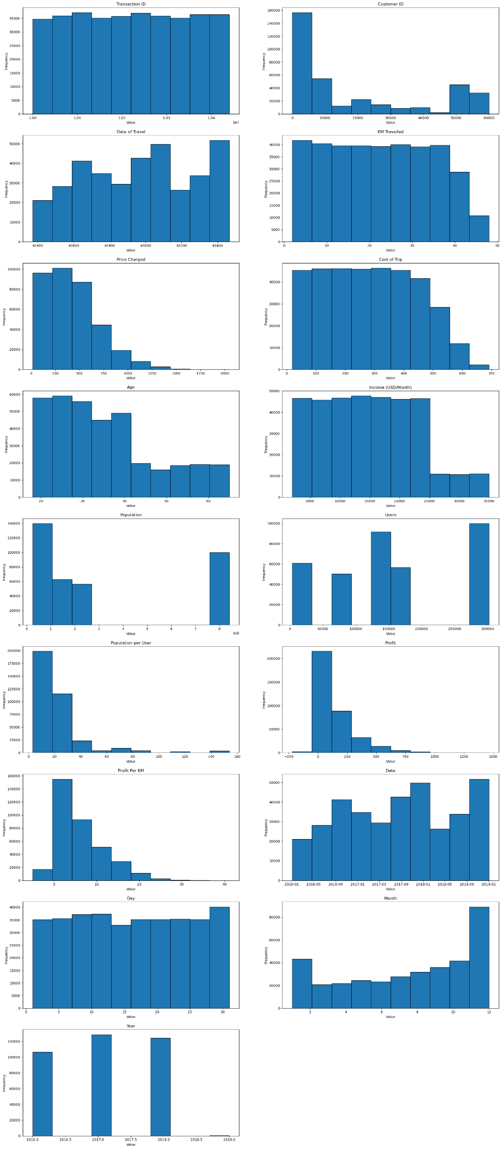
Descriptive Statistics
Categorical Features (Count Plot) Numerical Features (Histograms)
We could see:
KM Traveled is almost constant
Date of Traveled shows seasonality
Price Charged is right-skewed
Cost of Trip is tight-skewed
Age is also right-skewed
income is constant with steps
Population and Users are better to consider as categorical variables

Slide 6
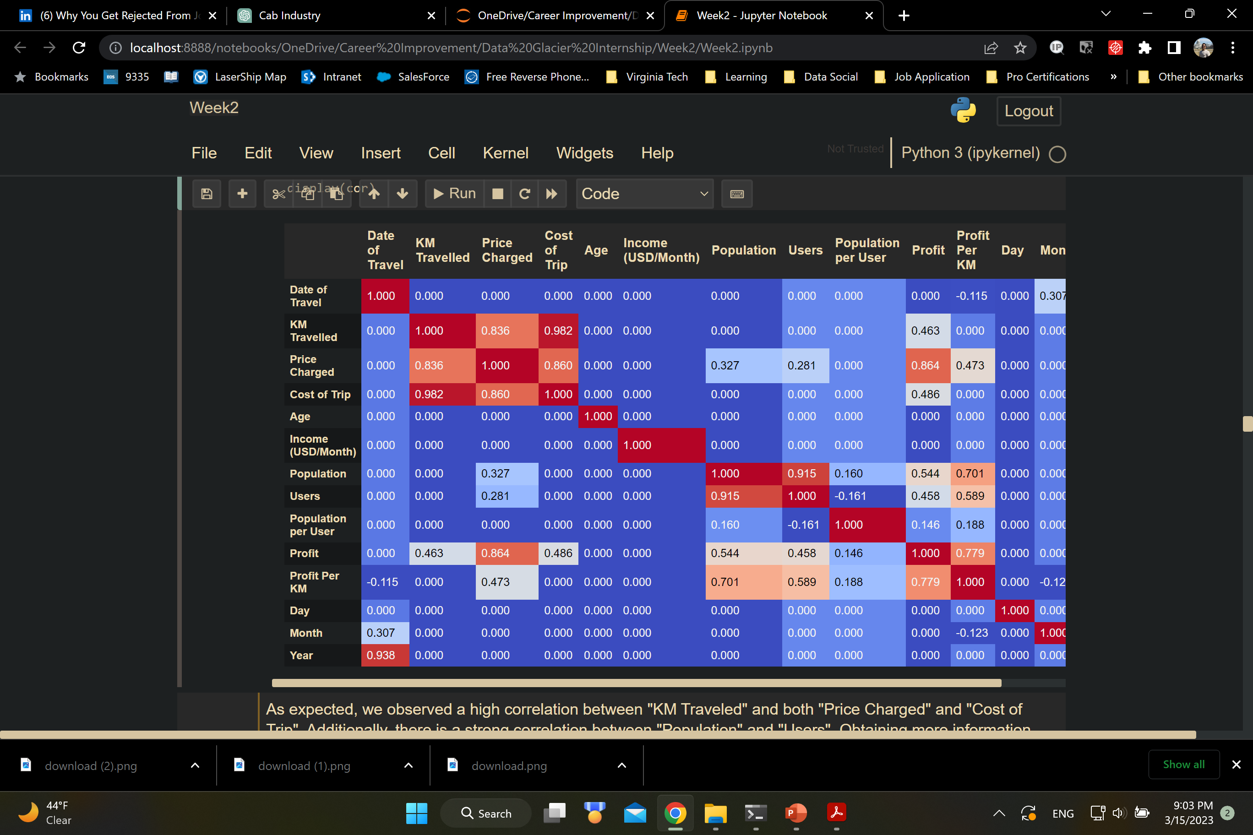
Correlation Analysis
As expected, we observed a high correlation between "KM Traveled" and both "Price Charged" and "Cost of Trip". Additionally, there is a strong correlation between "Population" and "Users". Obtaining more information about these predictors would be beneficial in gaining further insights.
We can see a strong linear relationship between 'KM Traveled', 'Cost of Trip', and 'Price Charged'. As expected, these predictors are highly correlated. However, to determine the best place to invest, we need to examine variable interactions rather than performing a regression analysis. For now, we can proceed as is, and later we can transform these variables to deal with the collinearity issue when performing regression analysis.

Slide 7
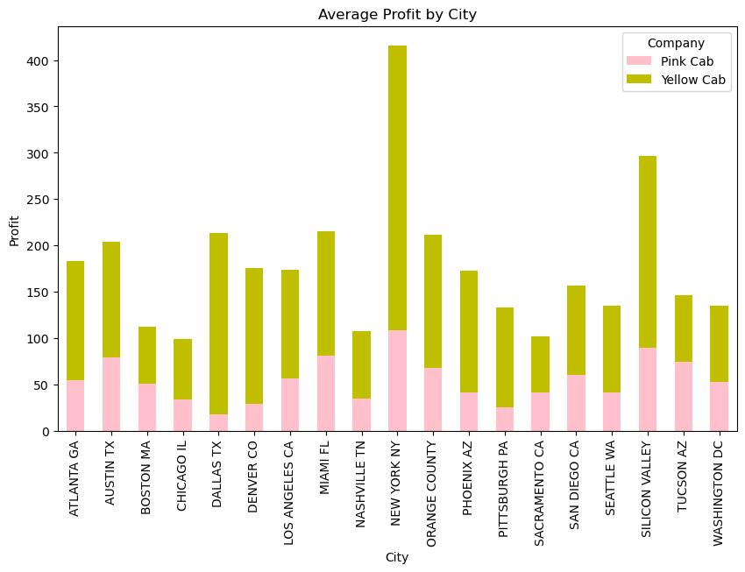
EDA (Profit By City)

Slide 8
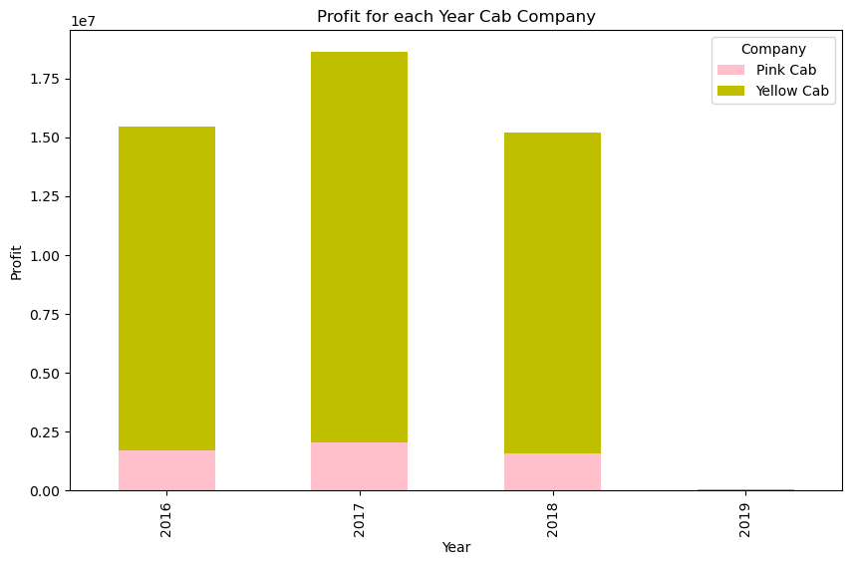
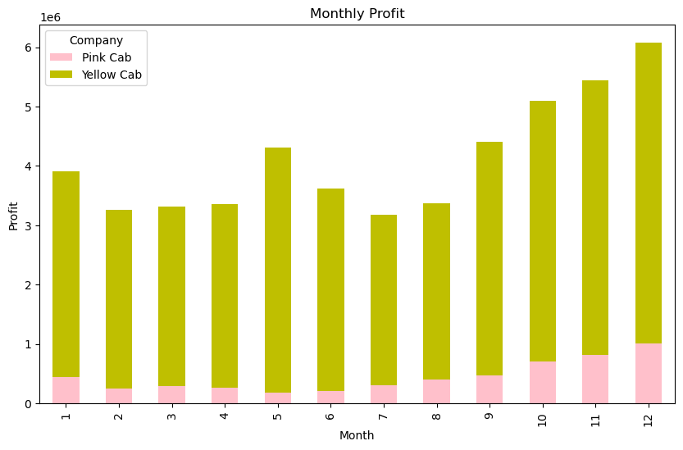
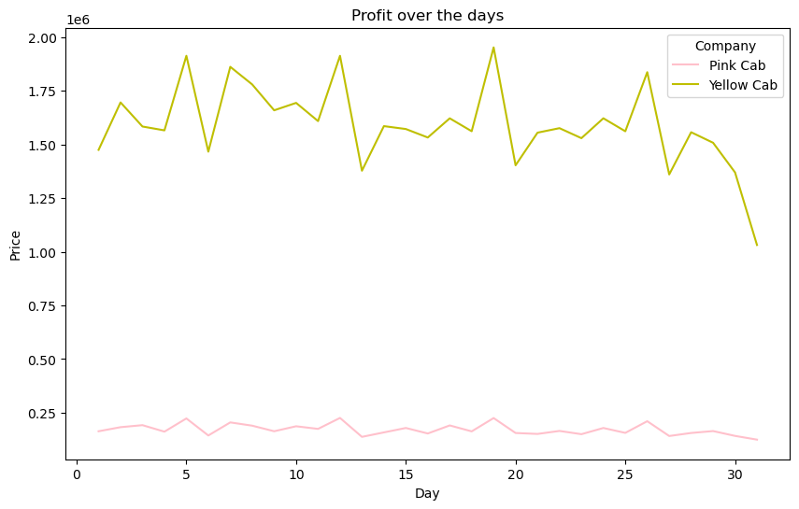
EDA (Profit-Time Analysis)

Slide 9
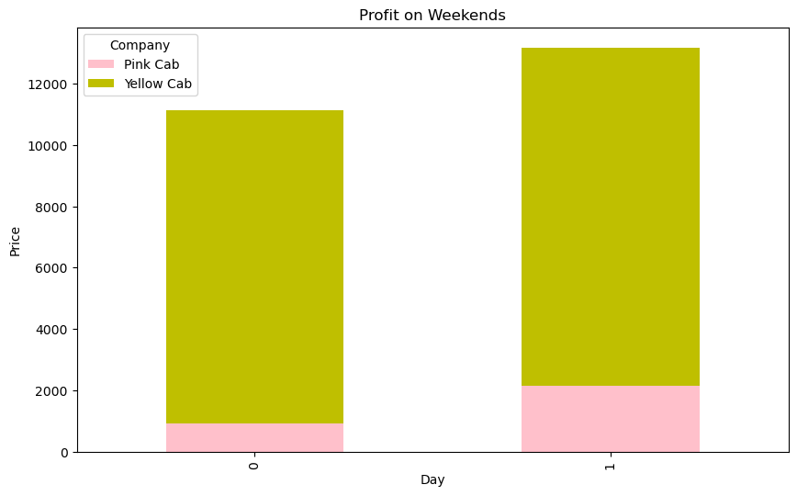
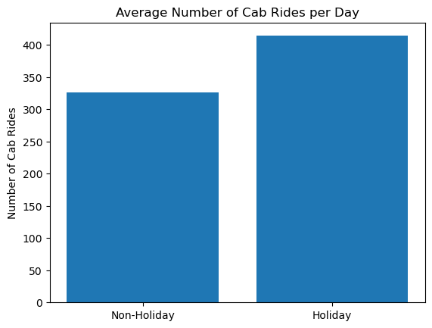
EDA (Weekend and Holidays)

Slide 10
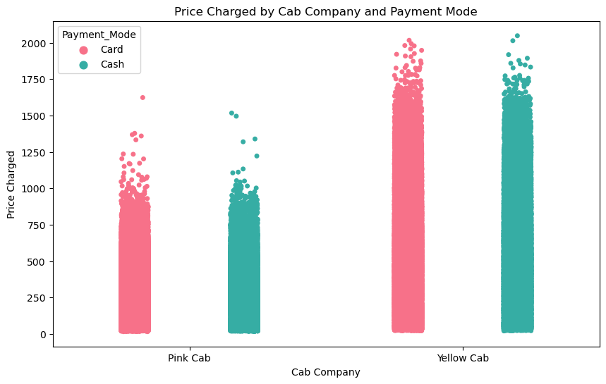
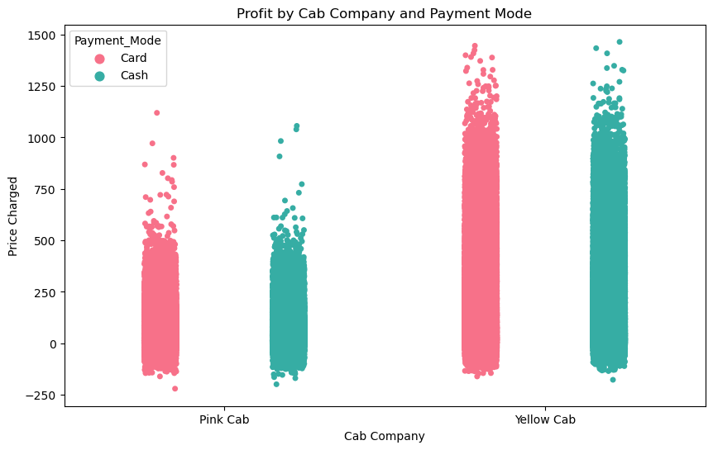
EDA (Payment Method)

Slide 11
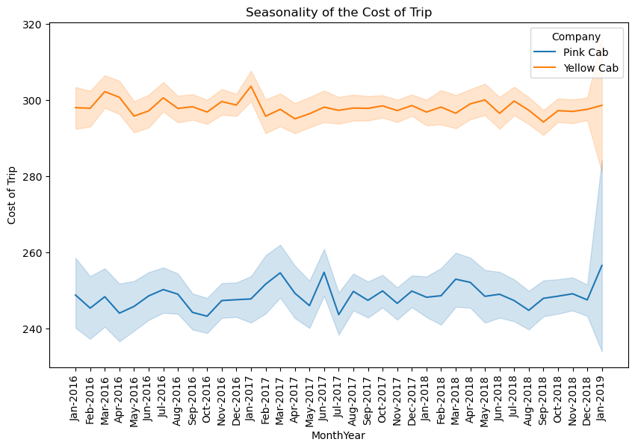
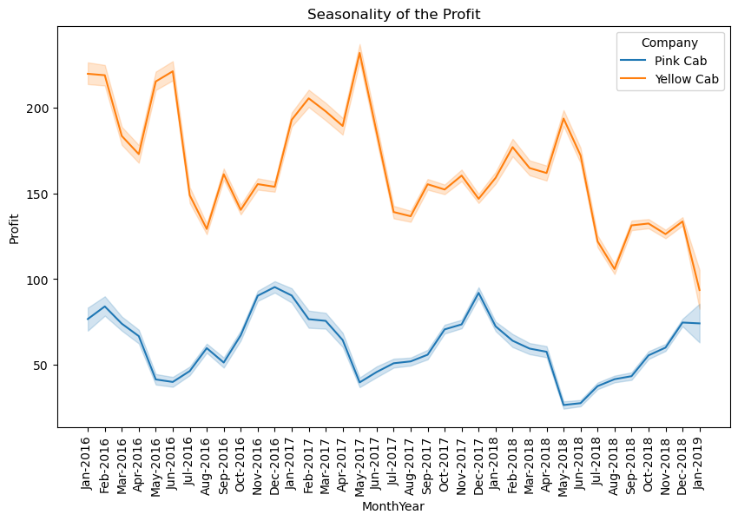
EDA (Seasonality of Profit and Cost)

Slide 12
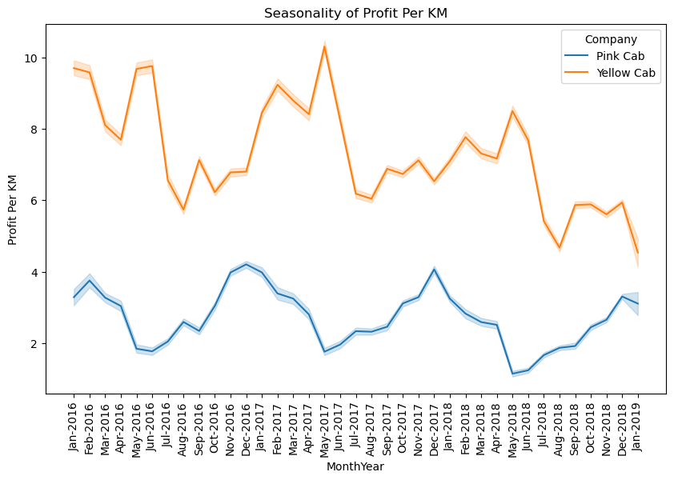
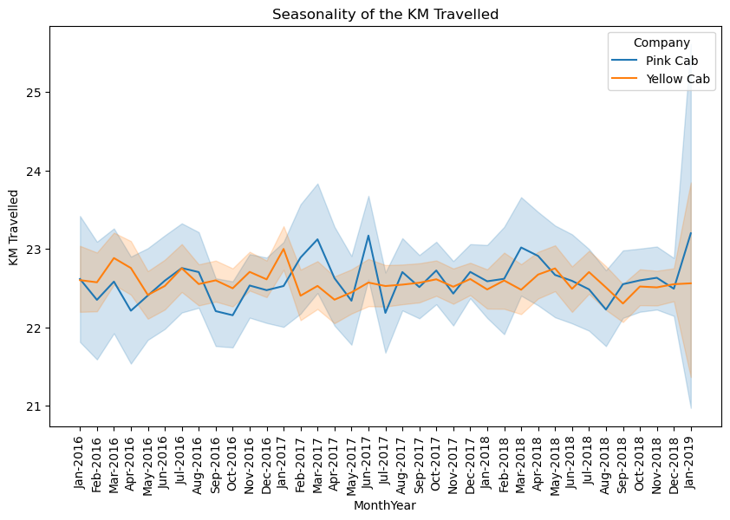
EDA (Variations in Distance and Profit for each KM)

Slide 13
EDA Summary
New York city has the most average profit follows by Silicon Valley and Miami city. We could see for almost all of the cities, average profit for Yellow cab company is higher except Tucson, AZ.
Seasonal trend during the months of May and June, as well as from September to December every year.
Hin May the KM travelled is almost same as other first half months, the profit is higher.
Considering the KM Travelled and by comparing it to the profit chart, we could see overall yellow cab company has higher profit in relation to the KM travelled.
If we set sample size for weekend and weekdays same and we could see, as expected, the weekend profit are higher.
Holiday's number of rides are 23 percent higher than regular days (weekdays and weekends).
Dealing with type of payments, customers who used Cards, spend more in yellow cab company however in the Pink Company they are almost the same.

Slide 14
Recommendations
However, the profit of the Yellow Cab Company is higher Overall, but the trend is downward. On the other hand, Pink Company is more stable with stable seasonality with the most profit on Nov, Dec, Jan.
We observed that the cost increased with an increase in the distance traveled (KM Traveled). However, the profit chart shows that despite the increase in distance traveled, the profit for the last month did not increase accordingly, and even the profit per KM decreases. We should notice this decrease happened in the Yellow company too, whoever this company did not face increase in cost or increase in KM Travelled, we could conclude this could be an external effect (regulation, policy or tax, etc).
We could notice the profit for the Yellow company at the end of each month decreases meaningfully.
Overall Yellow Cab company is better option to invest considering the margin of profit and the market share it holds, however, it need further evaluation to see why in the last months of 2018 of our dataset the profit start decreasing.

Slide 15

Thank You

